Slide 1
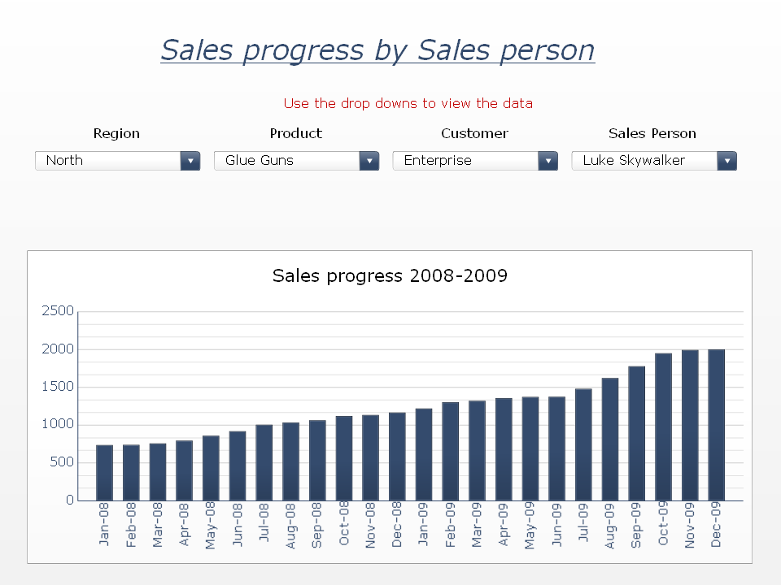
Notes:
IMPORTANT INFORMATION ABOUT XCELSIUS CONTENT EMBEDDED INTO THIS SLIDE - PLEASE READ ON IF YOU ARE EXPERIENCING DIFFICULTIES!
This PowerPoint slide has Xcelsius content embedded into it and certain restrictions apply:
1). Information message shown when you open this slide deck: "Some controls on this presentation can’t be activated. They might not be registered on this computer".
You need the latest Adobe Flash Player on your machine to view the embedded Xcelsius content:
a). Close PowerPoint - make sure you DO NOT SAVE this slide deck.
b). Using Internet Explorer install the latest Adobe Flash Player from adobe.com
c). Open this PowerPoint slide deck again.
2). A design-time thumbnail is not shown for the Xcelsius content when you open this slide deck until you enter and exit Slide Show mode.
3). Office 2007 files (.pptx) do not support Xcelsius embedded content - save as an Office 2003 file (.ppt) instead.
For more information refer to the Export to Microsoft Word 2007 and PowerPoint 2007 section in the Xcelsius release notes.
4). The Xcelsius visualization shows error code messages (#2048, etc).
Flash security restrictions have prevented the embedded Xcelsius content from accessing external data.
To allow the Xcelsius embedded content to access external data refer to the Adobe Flash Player - Security Issues section in the Xcelsius release notes.
Note: To allow embedded Xcelsius content in a PowerPoint slide you have to add POWERPNT.EXE as a trusted Adobe Flash application:
Office 2003 path example - C:\Program Files\Microsoft Office\OFFICE11\POWERPNT.EXE
Office 2007 path example - C:\Program Files\Microsoft Office\Office12\POWERPNT.EXE

